Slide 1
Visualization Mini-hack
Evidence-based Policymaking in Health and Social Service Agencies
October 1, 2019

Slide 2

What is Data Week DC?
Created by Data Community DC (DC2)
Non-profit promoting data science in the national capital region through high-quality community-driven events
13 Meetup groups
Comicon or SXSW for data professionals
Free, crowd-sourced conference at DC area venues
October 1 - 5

Slide 3
DC2 Meetups
Learn More
Blockchain DC
Data Education DC
Data Innovation DC
Data Science DC
Data Visualization DC
Data Wranglers DC
dHealth DC
Full Stack Data Science
Gender Diversity Around The Axis DC
GWU Data Science
Nova Deep Learning
Statistical Programming DC
Statistical Seminars DC
http://www.datacommunitydc.org/
https://www.meetup.com/Data-Community-DC/

Slide 4

DIVERSITY STATEMENT
Data Community DC believes that diverse communities are better and stronger. Together, we continue to build an inclusive culture that encourages, supports, and celebrates diversity in race, gender, sexual orientation, religion, and all protected classes. It connects and brings us closer. Everyone is welcome to come, speak, and volunteer as an inclusive community.

Slide 5

















Sponsors
ORGANIZATIONAL
SUPPORTING

Slide 6
Data Science @ Mathematica
Overview
Staff
20 data scientists on staff + 20-30 statisticians working in data science
Backgrounds
Physics Biostatistics Public health Env. health
Economics Mathematics Learning sciences Comp. science
Methods
Web scraping Network analysis
Natural language processing Predictive modeling
Machine learning Bayesian methods
Dynamic data visualization Agent-based modeling

Slide 7
Data Science @ Mathematica
Sample projects
Assessing opioid use among those with disabilities
(NLP to parse free text fields in SSDI applications to identify y/n opioid use)
Analyze Ryan White HIV/AIDS program
(Assess cost-effectiveness of program via agent-based models & network analysis)
Investigate online sales of WIC infant formula
(Web scraping & NLP to identify illegal sale of formula on e-commerce websites)
Ascertain unmet mental health treatment needs in military
(Semi-supervised ML w/admin & medical records to est unmet treatment needs)

Slide 8
Work @ Mathematica
No current openings
Coming Soon
Human Services Area: predictive modeling expertise
Track our external page

Slide 9
The Design Challenge
How do you make highly technical data accessible and actionable for non-technical audiences?
How can data visualization techniques engender user empathy to overcome stigma, disrupt entrenched systems, and foster honest communication for the public good?

Slide 10
Your Charge
Using or reflecting on real data, reimagine and prototype your own design solution to one of two policy and program issues:
Help service providers, program administrators, policymakers and their constituents anticipate the implications of proposed changes to the Supplemental Nutrition Assistance Program’s eligibility rules
Improve access to treatment and recovery services to address the opioid crisis

Slide 11
Guidelines
Use the medium or platform of your choosing (e.g., D3, RShiny, Tableau, paper and pencil)
Datasets are available here
Hack away (80 minutes)
Work individually or in small groups
Breakout room available
SMEs available for feedback and questions
Hack and tell (20 minutes)
Expert feedback (10 minutes)

Slide 12
Subject Matter Experts
Gina Hijjawi, Senior Program Officer, Robert Wood Johnson Foundation
Steven Daviss, President and Co-founder, FUSE Health Strategies LLC
Kevin Dorrance, Chief Executive Officer, TransformCare
Diane Seibert, Associate Dean of Academic Affairs, Uniformed Services University
Karen Cunnyngham, Associate Director, Mathematica
Sarah Lauffer, Senior Research Programmer, Mathematica
Aparna Keshaviah, Senior Statistician, Mathematica
Fei Xing, Senior Data Scientist, Mathematica
Alma Vigil, Systems Analyst, Mathematica

Slide 13
S.T.Op NextGen Challenge
Stopping the Transmission of Opioids to the Next Generation
Aparna Keshaviah • Fei Xing • Melissa Azur • Mark Timms
October 1, 2019

Slide 14
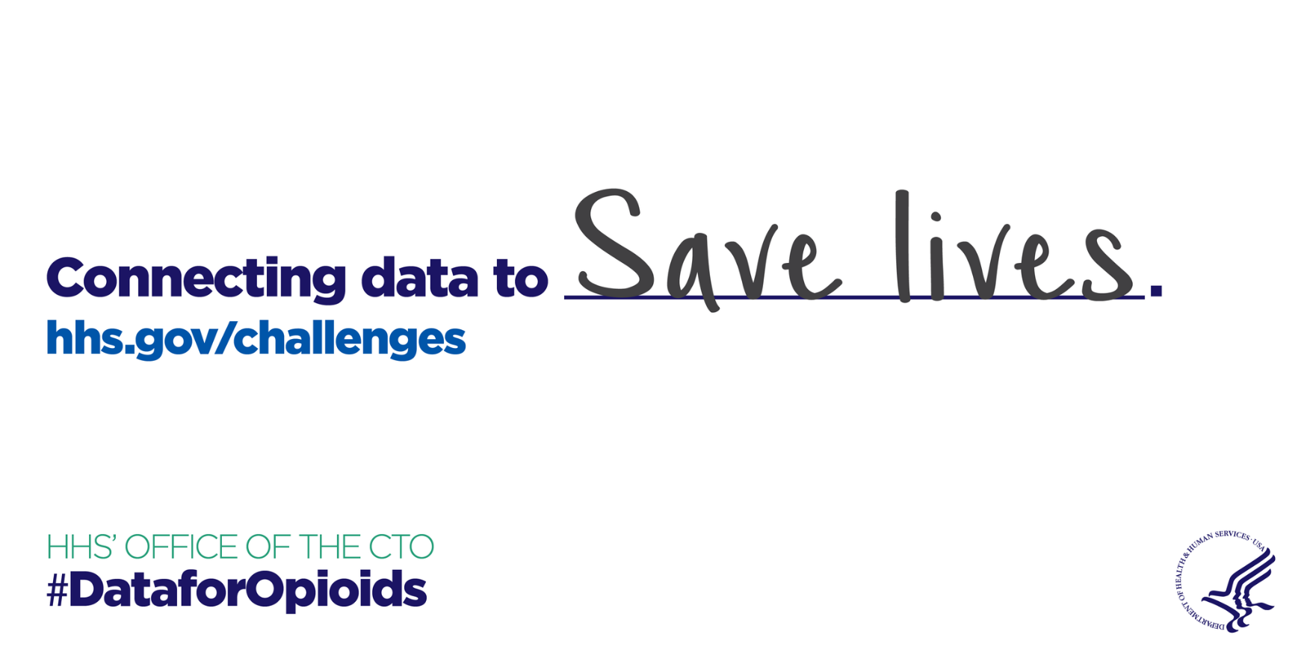
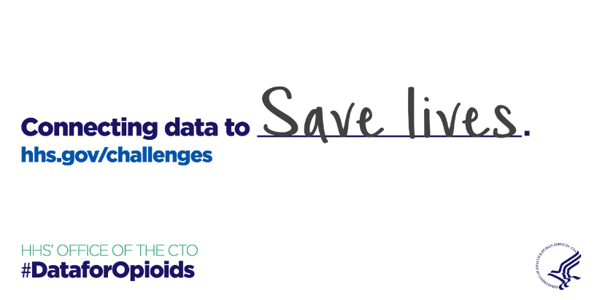

The Challenge How can you help federal, state, and local stakeholders improve access to effective treatment and recovery services to reduce opioid-related overdoses, mortality, & addiction/dependence?

Slide 15
Our Solution
target MANY by targeting one women of child-bearing age

Slide 16
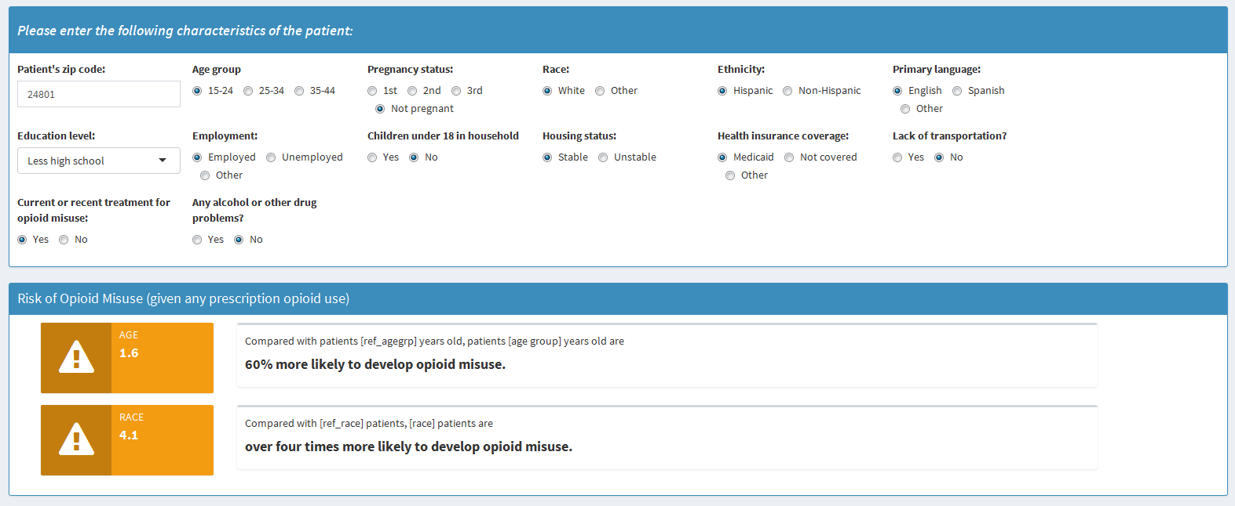
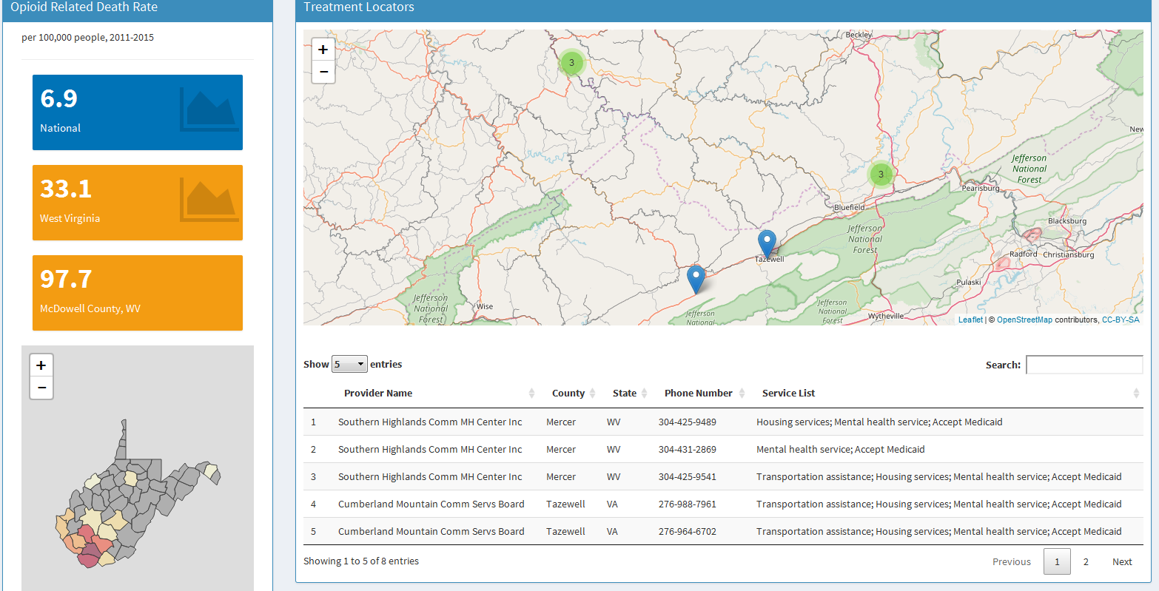
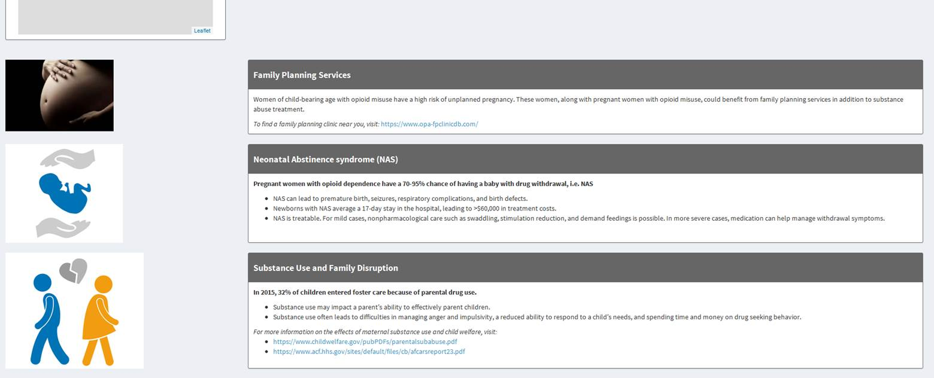
S.T.Op NextGen http://stop-nextgen.mathematica-mpr.com/
Empower providers
…Connect patients with treatment & resources
…Understand factors that increase risk for misuse
…Be equipped for difficult conversations
Prevent opioid misuse transmission (physical, social, environmental)

Slide 17
Dataset overview
Source | Description | Dataset name | Level of organization | Types of variables
SAMHSA | Behavioral Health Treatment Services Locator (2017) | dat_service_locator_2017.csv | 1 record per treatment facility | * List of treatment services * Facility location * Ancillary support services (e.g. child care, transportation)
CDC WONDER | Multiple Causes of Death (2013-2017) | opioid_deaths_CDC_bystate.csv | 1 record per state per demographic group (restricted to F, ages 15-44) | * Opioid-related deaths * Population size * Opioid-related death rate * Age group, race, ethnicity
 |  | opioid_deaths_CDC_bycounty.csv | 1 record per county per demographic group (restricted to F, ages 15-44)
NSDUH | National Survey on Drug Use and Health (2013-2017) | nsduh_2013to2017.csv | 1 record per individual surveyed | * Opioid misuse * History of drug/alcohol issues * Demographics
GEO | Geocoding data | counties_adj_list.csv |  | County neighbor list
 |  | us_geo_clean.csv | Merge based on stateFIPS or countyFIPS | US zip code data
 |  | cb_2016_us_state_20m\[files] |  | US state shape files
 |  | cb_2016_us_county_20m\[files] |  | US county shape files

Slide 18
The Challenge How can you help federal, state, and local stakeholders improve access to effective treatment and recovery services to reduce opioid-related overdoses, mortality, & addiction/dependence?

Slide 19
Questions?
Aparna Keshaviah
AKeshaviah@mathematica-mpr.com
Fei Xing
FXing@mathematica-mpr.com

Slide 20
Impact of Proposed Changes to SNAP “Broad-Based Categorical Eligibility”
A State-by-State Visual Analysis
Sarah Lauffer, Karen Cunnyngham, and Alma Vigil
October 1, 2019

Slide 21
Our challenge: To analyze the scale of the proposed SNAP policy changes and provide stakeholders with state-level statistics to better assess regional and demographic impacts.

Slide 22
Start to Finish Under a Tight Timeline
Select the right analysis format
Design and develop the visualization
Brainstorm dissemination strategies
Sept. 2
Release the viz!
Sept. 23
Comment period closes
July 24
Proposed rule is announced in the federal register
Notes:
We knew what the challenge was – we had 60 days in total to get this data into the hands of vested individuals.
Think about the audience – who are we hoping will utilize the data – what format increases attention and usability?

Slide 23
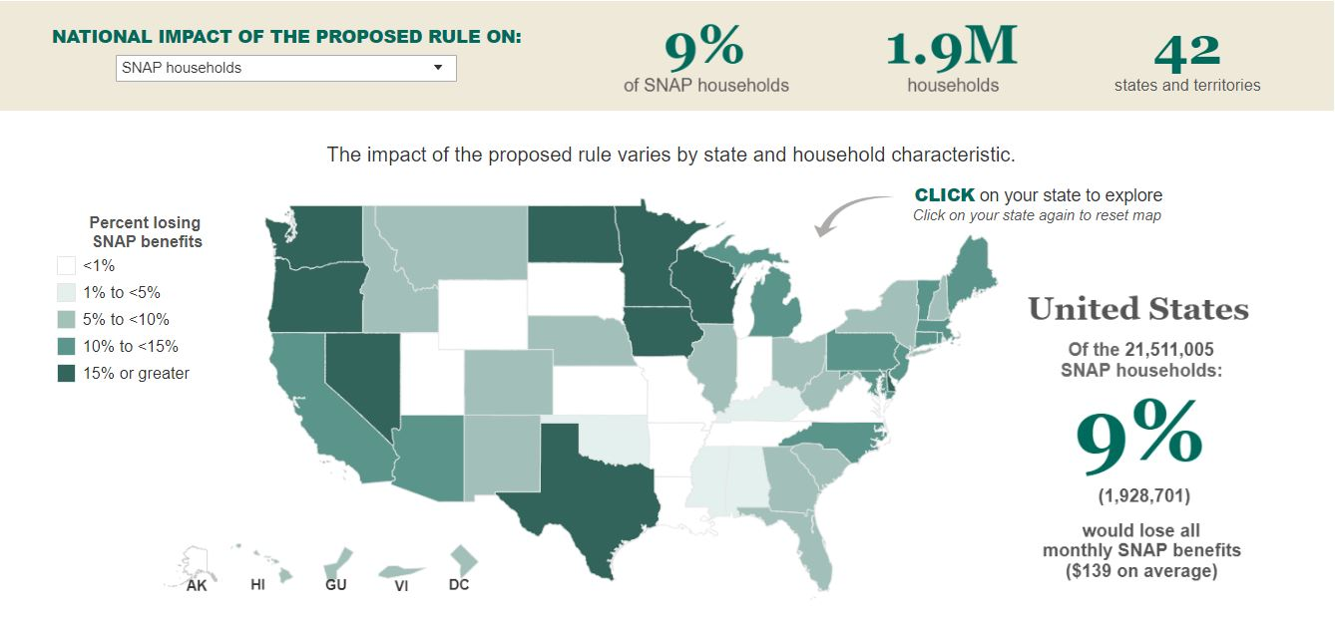
The Product
Notes:
We knew what the challenge was – we had 60 days in total to get this data into the hands of vested individuals. Providing evidence in the delivery of comments

Slide 24
The Data.

Slide 25
Questions?

Slide 26
Hack Away!

Slide 27
Hack and Tell Time!

Slide 28
Thank you!!!!

Slide 29
Please submit your design and complete our event feedback form

Slide 30
Data Week DC 2019 Highlights
October 2
Risk, Mobile Phones, Drugs, and Uncertainty: Applied Data Science in the Wild
October 3
Careers in Data Viz Panel
October 4
Capital One's Data Science internship program
LGBTQ+ Data Exploration!
October 5
Learning Data Science/Local authors/ Revisit Analyzing the Analyzers study
“Dooms Data Preppers” Survey
“Data Me Donate” Data Viz Design Challenge ($500, $250 and $100 prizes)

Slide 31
So long, farewell, auf Wiedersehen, good night… Let’s make haste to Wunder Garten!

